Slide 1
Parsing
Part I

Slide 2
Language and Grammars
Every (programming) language has precise rules
In English:
Subject Verb Object
In C
programs are made of functions
» Functions are made of statements etc.

Slide 3
Parsing
A.K.A. Syntax Analysis
Recognize sentences in a language.
Discover the structure of a document/program.
Construct (implicitly or explicitly) a tree (called as a parse tree) to represent the structure.
The above tree is used later to guide translation.

Slide 4
Role of the parser
tokens
Intermediate representation
Scanner
(lexical
analysis)
Parser (syntax analysis)
Symbol Table
Source program
Parse tree
Rest of front end
Get next tokens
Verifies if the string of token can be generated from the grammar
Error?
Report with a good descriptive, helpful message
Recover and continue parsing!
Build a parse tree !!
Rest of Front End
Collecting token information
Type checking
Intermediate code generation

Slide 5
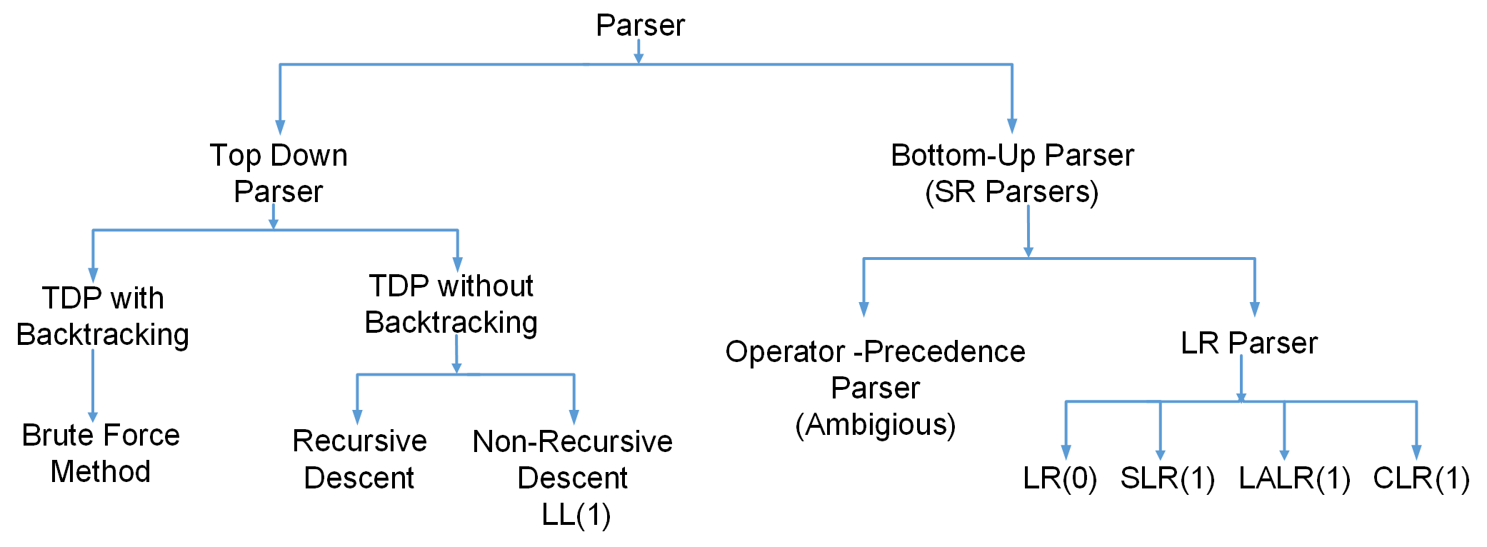
Parser Hierarchy
SR = Shift Reduce
Shift means pushing
Reduce means popping
So it uses a stack
LR = Left-to-right, Rightmost derivation in reverse
In TDP without backtracking, LR and Non-Determinism is not accepted
Only Operator Precedence Parser can pass Ambiguous Grammars

Slide 6
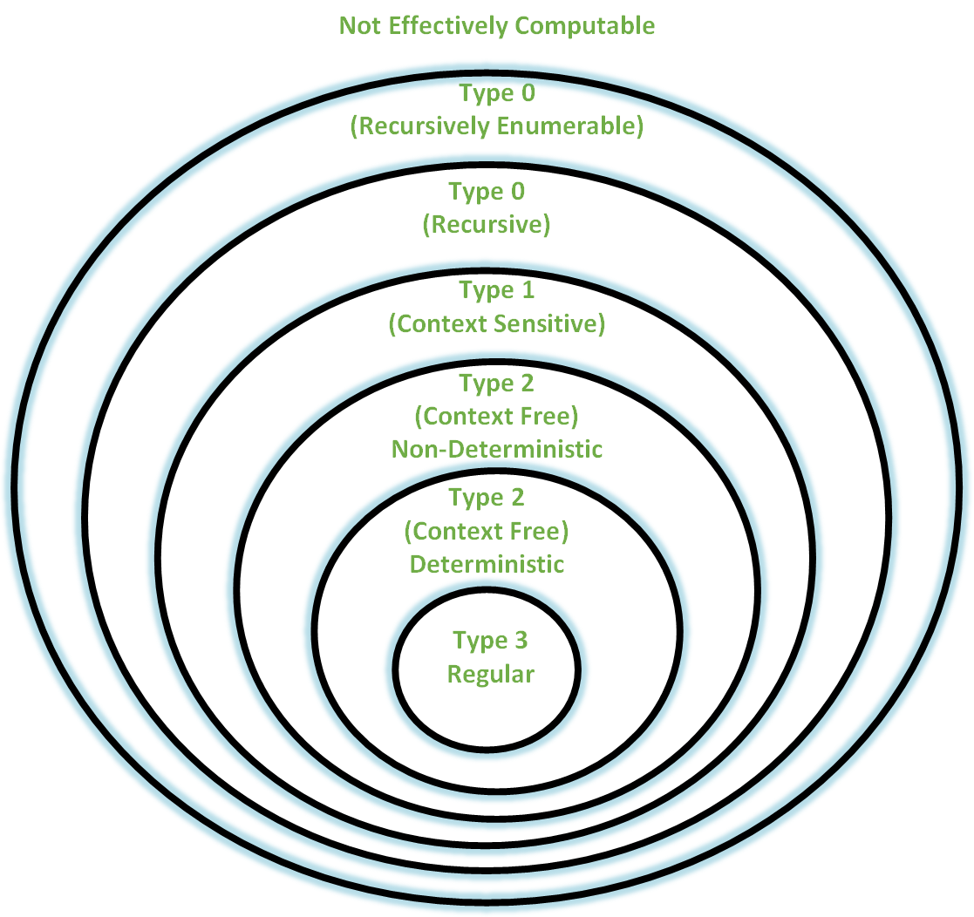
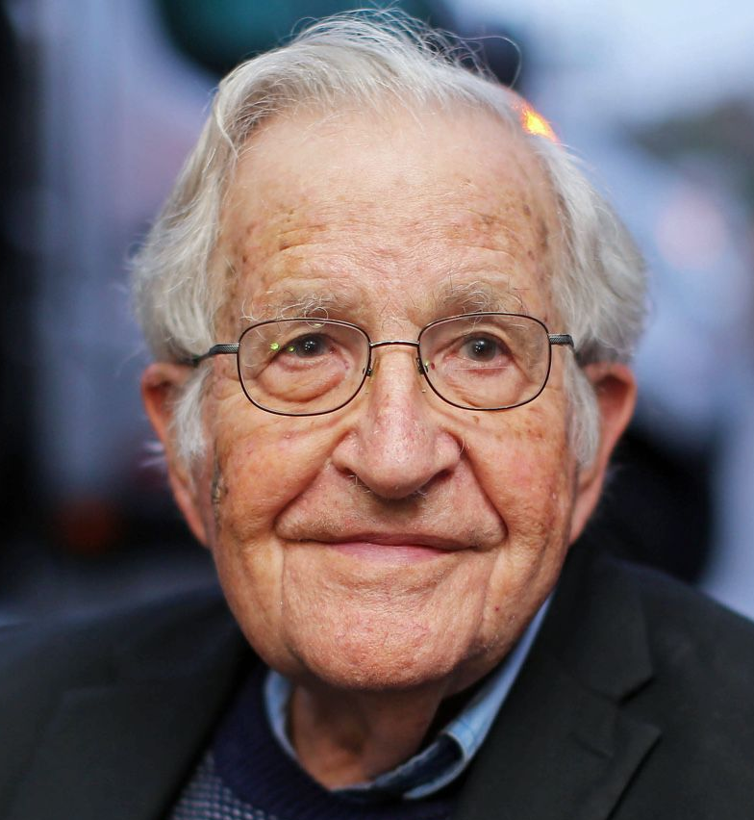
Chomsky Hierarchy

Slide 7
Chomsky Hierarchy
Naom Chomsky introduced a mathematical model of grammar which is effective for writing computer languages
Type of Grammar | Grammar Accepted | Language Accepted | Automaton
Type-0 | Unrestricted (free) Grammar | Recursively Enumerable Language | Turing Machine (Most flexible and most powerful)
Type-1 | Context Sensitive Grammar | Context Sensitive Language | Linear Bounded Automaton
Type-2 | Context Free Grammar | Context Free Language | Pushdown Automata
Type-3 | Regular Grammar | Regular Language | FSA (Least flexible and least powerful)
Power in the sense, type of languages for which it can construct a grammar
Most of the programming language will be under CGFs

Slide 8
Grammar
A 4-tuple G = <V_{N} , V_{T}, P, S> of a language L(G)
Where, -- V_{N} is set of nonterminal symbols used to write the grammar
-- V_{T} is the set of terminals (set of words in the language L(G))
-- P is a set of production rules such as a 🡪 b where a and b are strings on V_{N} U V_{T} and atleast one of a belongs to V_{N}
-- S is a special symbol V_{N} called the start symbol of the grammar
Strings in language L(G) are those derived from S by applying the production rules from P
Examples:
E → E + T | T
T → T*F|F
F → (E) | ID
E → TE’
E’ → +TE’ | ε
T → FT’
T’→ *FT’ | ε
F → (E) | ID

Slide 9
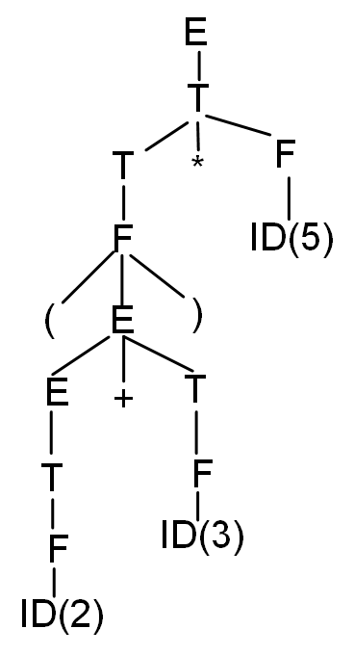
(2+3)*5
E → E + T | T
T → T*F|F
F → (E) | ID

Slide 10
(2+3)*5
E
T
E’
F
T’
ε
(
E
)
*
F
T
E → TE’
E’ → +TE’ | ε
T → FT’
T’→ *FT’ | ε
F →(E) | ID
T
E’
ID(2)
ε
F
T’
ID(2)
ε

Slide 11
2+3*(4*5)
E | → | E+T
 | → | E+T*F | [T→T*F]
 | → | E+T*(E) | [F→ (E)]
 | → | E+T*(T) | [E→T]
 | → | E+T*(T*F) | [T→T*F]
 | → | E+T*(T*id) | [F→id]
 | → | E+T*(F*id) | [T→F]
 | → | E+T*(id*id) | [F→id]
 | → | E+F*(id*id) | [T→F]
 | → | E+id*(id*id) | [F→id]
 | → | T+id*(id*id) | [T→F]
 | → | F+id*(id*id) | [F→id]
 | → | id+id*(id*id)
 | → | 2+3*(4*5)
E → E + T | T
T → T*F|F
F 🡪 (E) | ID

Slide 12
Errors in Programs
Lexical
if x<1 thenn y = 5:
“Typos”
Syntactic
if ((x<1) & (y>5))) ...
{ ... { ... ... }
Semantic
if (x+5) then ...
Type Errors Undefined IDs, etc.
Logical Errors
if (i<9) then ... Should be <= not <
Bugs
Compiler cannot detect Logical Errors

Slide 13
Goals for Handling Errors
Compiler works in a fashion in which it produces all the error messages together. But doing this is very difficult as the parser is working based on automata where it can be difficult to come to a clean state from another state.
Reporting the error precisely
Recovering from each error quickly enough to detect the subsequent errors
The compiler should add minimum overhead to the processing of correct programs

Slide 14
Error Detection
Much responsibility on Parser
Many errors are syntactic in nature
Precision/ efficiency of modern parsing method
Detect the error as soon as possible
Challenges for error handler in Parser
Report error clearly and accurately
Recover from error and continue..
Should be efficient in processing
Good news is
Simple mechanism can catch most common errors
Errors don’t occur that frequently!!
60% programs are syntactically and semantically correct
80% erroneous statements have only 1 error, 13% have 2
Most error are trivial : 90% single token error
60% punctuation, 20% operator, 15% keyword, 5% other error

Slide 15
Adequate Error Reporting is Not a Trivial Task
Difficult to generate clear and accurate error messages.
Example
function foo () {
...
if (...) {
...
} else {
...
Missing } here
...
}
<eof>
Example
int myVarr;
...
x = myVar;
...
Not detected until here
Misspelled ID here
Not detected until here

Slide 16
Error Recovery
After first error recovered
Compiler must go on!
Restore to some state and process the rest of the input
Error-Correcting Compilers
Issue an error message
Fix the problem
Produce an executable
Example
Error on line 23: “myVarr” undefined.
“myVar” was used.
May not be a good Idea!!
– Guessing the programmers intention is not easy!

Slide 17
Error Recovery May Trigger More Errors!
Inadequate recovery may introduce more errors
– Those were not programmers errors
Example:
int myVar flag ;
...
x := flag;
...
...
while (flag==0)
...
Declaration of flag is discarded
Variable flag is undefined
Variable falg is undefined
Too many Error message may be obscuring
May bury the real message
Remedy:
allow 1 message per token or per statement
Quit after a maximum (e.g. 100) number of errors

Slide 18
Error Recovery Approaches: Panic Mode
Discard input symbol one at a time until one of designated set of synchronization token is found.
Example of synchronization tokens are: ;, }. It depends on the programming language
If discarding a semicolon is not sufficient, it discards the subsequent statements till it come to a closing brace.
So, an entire block can be skipped if necessary
The key...
Good set of synchronizing tokens
Knowing what to do then
Advantage
Simple to implement
Does not go into infinite loop
Commonly used
Disadvantage
May skip over large sections of source with some errors
Example
Skip to next occurrence of
} end ;
Resume by parsing
the next statement

Slide 19
Error Recovery Approaches: Phrase-Level Recovery
Compiler corrects the program
Replace a prefix of remaining input by some string that allows the parser to continue
by deleting or inserting tokens
...so it can proceed to parse from where it was.
The key...
Don’t get into an infinite loop
...constantly inserting tokens and never scanning the actual source
Generally used for error-repairing compilers
– Difficulty: Point of error detection might be much later the point of error occurrence
do
Example:
while (x==4) y:= a + b
Insert do to fix the statement

Slide 20
Error Recovery Approaches: Error Productions
There are set of production rules which tells how a valid statement is generated
Compiler designer can think the possible errors an user can make and add some extra production rules called “Error Productions”
Augment the CFG with “Error Productions”
Now the CFG accepts anything!
Suppose, a production rule defines:
s → if Condition then Statement else Statement
While designing a compiler, a common error the user can do is to forgetting the then. So, the compiler designer can add a error production:
s → if Condition Statement else Statement
Used with...
LR (Bottom-up) parsing
Parser Generators

Slide 21

Error Recovery Approaches: Global Correction
Theoretical Approach
Find the minimum change to the source to yield a valid program with least cost correction
– Insert tokens, delete tokens, swap adjacent tokens
Global Correction Algorithm
Input: grammatically incorrect input string x; grammar G
Output: grammatically correct string y
Algorithm: converts x 🡪 y using minimum number changes (insertion, deletion etc.)
Another example, undeclared variable x
Impractical algorithms - too time consuming

Slide 22
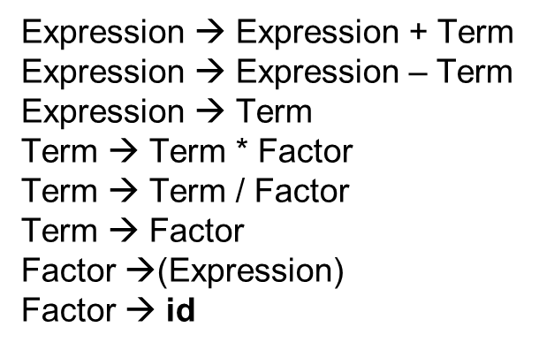
Context Free Grammars (CFG)
A context free grammar is a formal model
that consists of:
Terminals
Keywords
Token classes
Punctuations
Non-terminals
Any symbol appearing on the lefthand
side of any rule
Start Symbol
Usually the non-terminal on the
lefthand side of the first rule
Rules (or “Productions”)
BNF: Backus-Naur Form /
Backus Normal Form
Stmt ::= if Expr then Stmt else Stmt

Slide 23
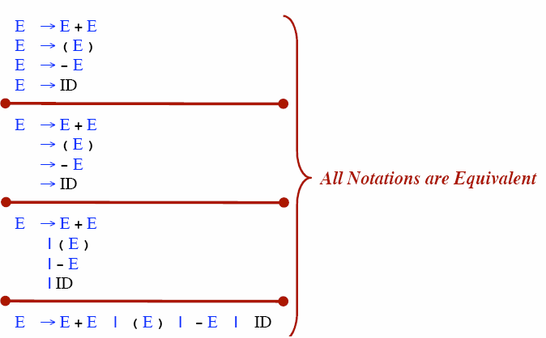
Rule Alternative Notations

Slide 24
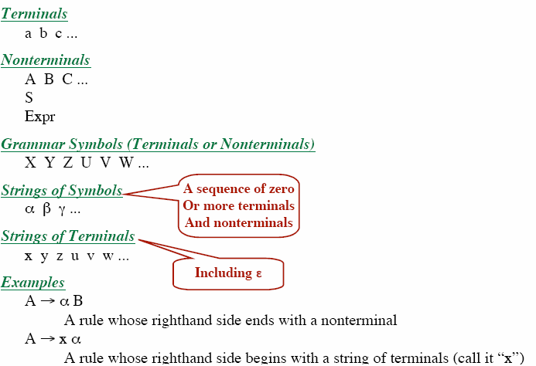
Notational Conventions

Slide 25
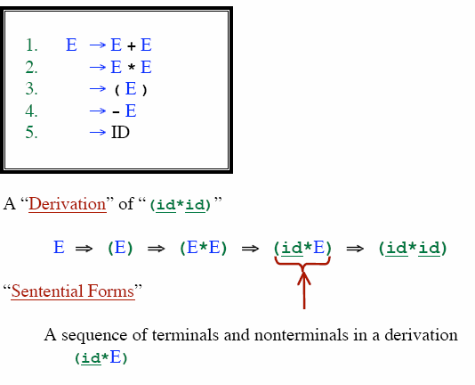
Derivations
Productions are treated as rewriting rules to generating a string

Slide 26
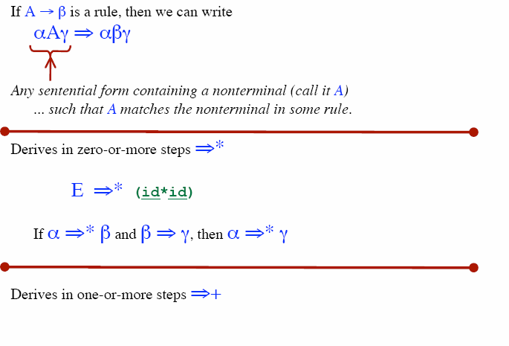
Derivation

Slide 27
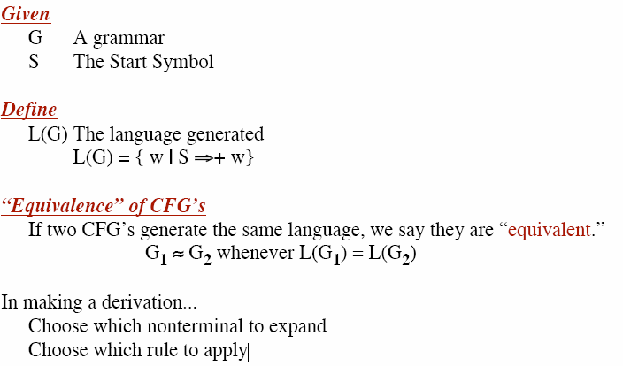

Slide 28
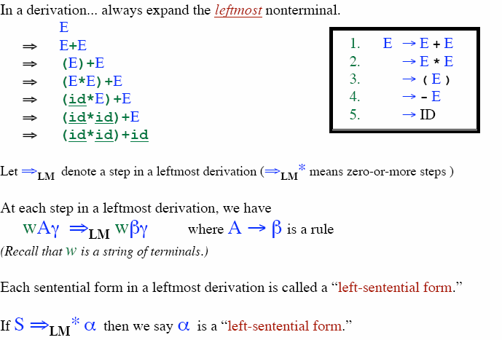
Leftmost Derivation

Slide 29
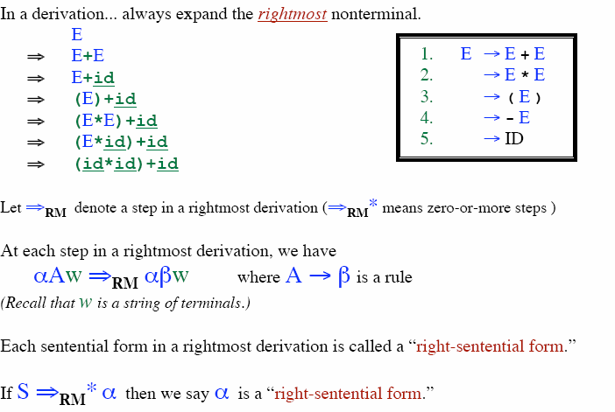
Rightmost Derivation

Slide 30
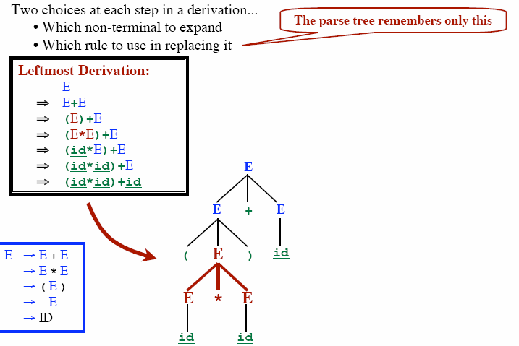
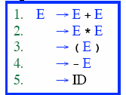
Parse Tree

Slide 31
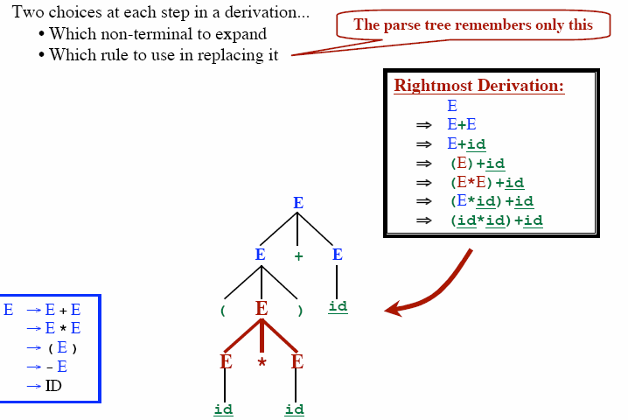
Parse Tree

Slide 32
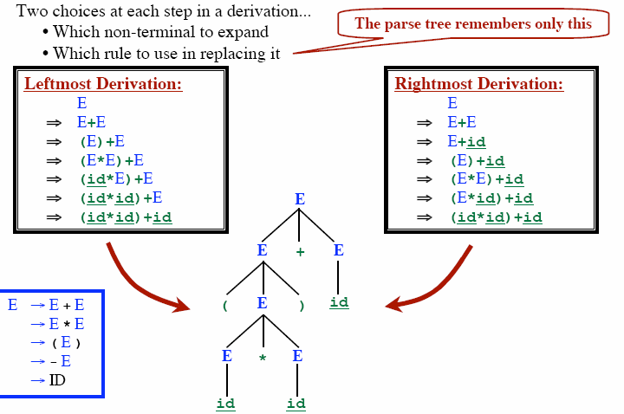
Parse Tree

Slide 33
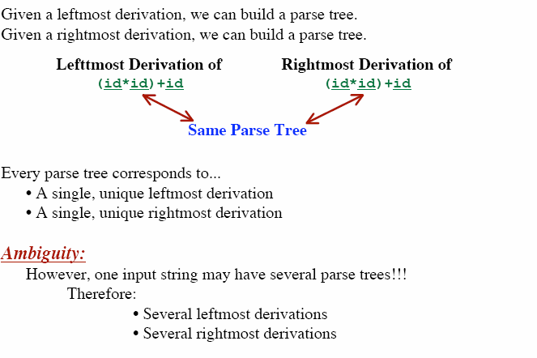
Parse Tree

Slide 34
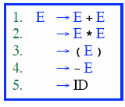
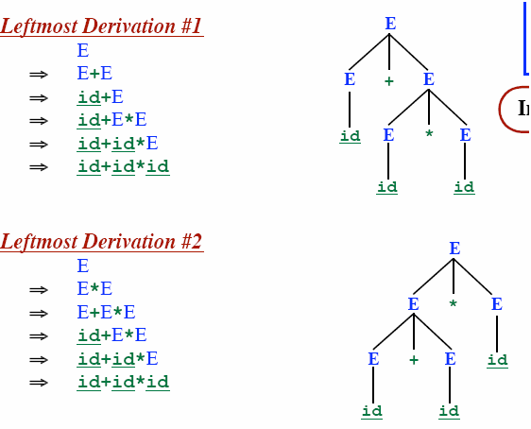

Ambiguous Grammar

Slide 35
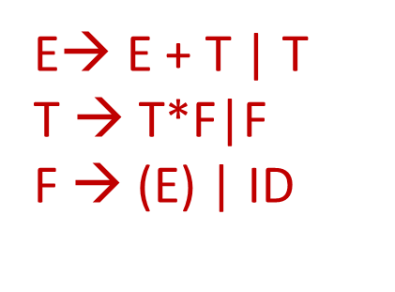
Ambiguous Grammar
If we consider the precedence of this addition and multiplication,
Multiplication has higher precedence. So in the parse tree where addition is done at first will not be accepted
But if the precedence is not mentioned, both of them are correct
This E-T-F grammar does not have any ambiguity
Because, it says, for applying the rule first T has to be derived where T takes care of the multiplication function

Slide 36
Ambiguous Grammar
More than one Parse Tree for some sentence.
The grammar for a programming language may be ambiguous
Need to modify it for parsing.
Also: Grammar may be left recursive.
Need to modify it for parsing.

